Slide 1
DIP Proposal Image Morphology Team: The Big Dipper
Team Members: Patrick Byrnes, Daria Martin, Jeffry Sandoval, Jeffrey Pernia, Chinemerem Njoku, Austin Ma, And Rami Ghannam

Slide 2
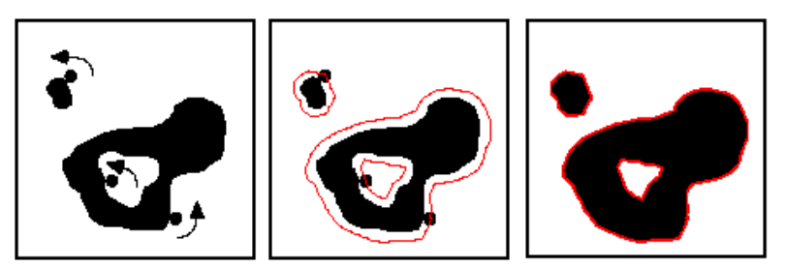
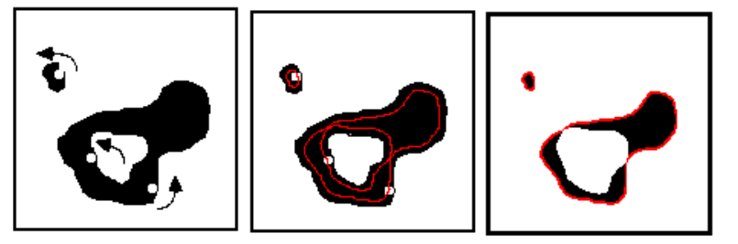
What is Image Morphology?
Dilation
Image morphology is a method for analyzing and processing shapes within an image. The basic building blocks of morphological operations are erosion, dilation, opening, and closing.
Dilation is applying an OR operation to a binary image
Erosion is applying an AND operation to a binary image
Opening is applying Erosion followed by Dilation.
Closing is applying Dilation followed by Erosion.
There are other operations such as Open-Close and Close-Open which build on the above.
There is also Boundary Extraction which finds pixels on the boundary of objects within an image
Skeletonization is a way of obtaining an image’s skeleton
Erosion

Slide 3
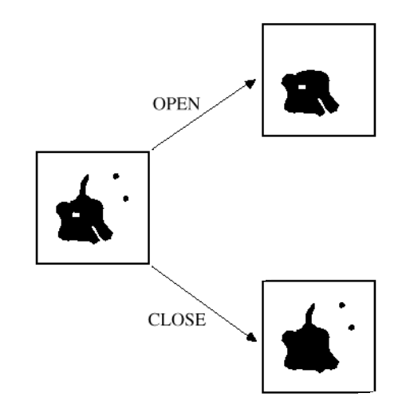
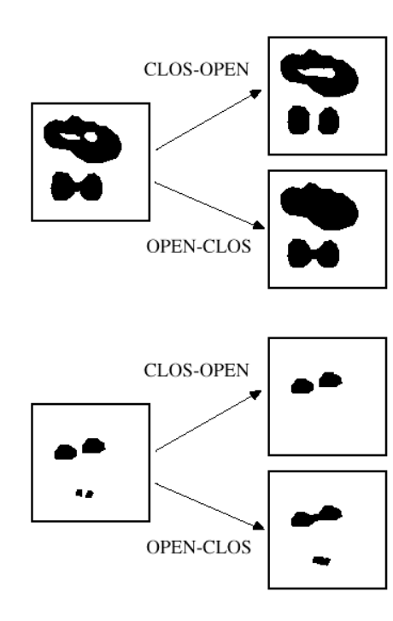
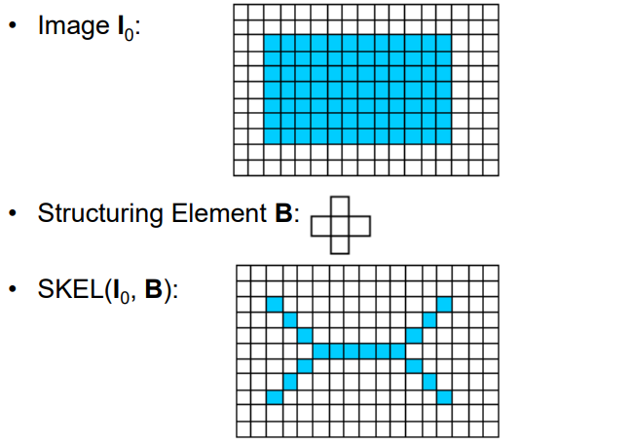

Slide 4
Subtopics we plan to implement
Erosion and Dilation
Opening and Closing
Open-Close and Close-Open
Boundary Extraction
Skeletonization

Slide 5
Objective
To create an application with a basic GUI that shows the effects of Erosion, Dilation, Opening, Closing, Open-Close, Close-Open, Boundary Extraction, and Skeletonization on any image the user inputs. This application can be used to study and better understand the concepts within Image Morphology.

Slide 6
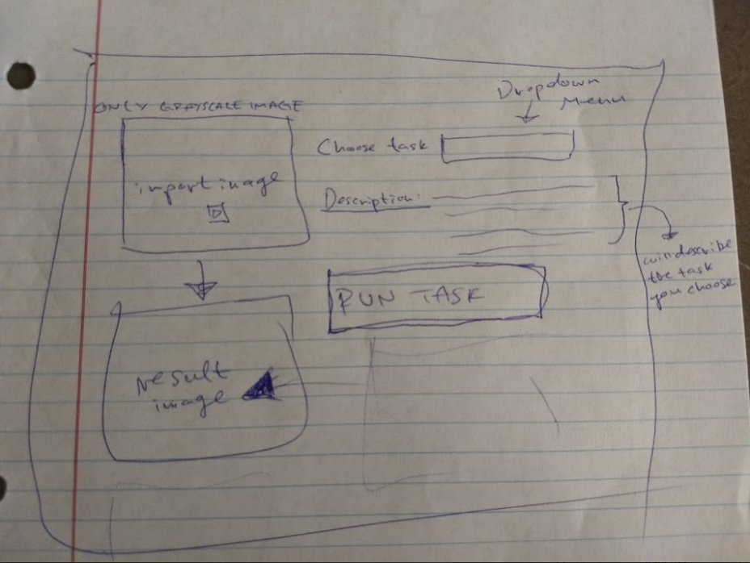
GUI

Slide 7
Member Responsbilities
GUI:
Chinemerem Njoku
Jeffry Sandoval
Erosion, Dilation, Opening, Closing, Open-Close and Close-Open:
Patrick Byrnes
Rami Ghannam
Jeffrey Pernia
Boundary Extraction and Skeletonization:
Daria Martin
Austin Ma
Presentations and Report:
Rami Ghannam

Slide 8
Functionality
The user will input an image. This image will then be converted to greyscale. The user will select which morphological operation they wish to perform. The resulting image will be displayed and can be compared to the original to see the effect of the operation.

Slide 9
Languages, Libraries, and Functions
Languages our application will be written in:
Python for back-end
JavaScript for front-end
Libraries & Functions we plan to use:
CV2
Read in image and convert to greyscale, convert them to matrices, and converting them back to images
Numpy
Padding, Copying
Libraries & Functions we do not plan to use:
Anything that performs the actual morphological algorithm. We will write these ourselves.

